Slide 1
QUEUE
Presented by:Prasuna Sapkota

Slide 2
TABLE OF CONTENTS
Introduction
Array representation of Queue
Circular Queue

Slide 3
Introduction to Queue
Queue is an important data structure which stores its elements in an ordered manner.
We can explain the concept of queues using the following analogy: People moving on an escalator. The people who got on the escalator first will be the first one to step out of it.
A queue is a FIFO (First-In, First-Out).

Slide 4
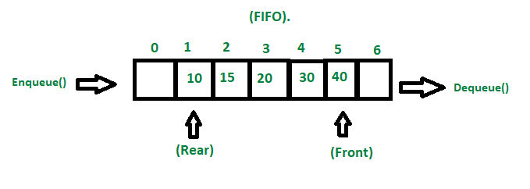

Fig:Queue

Slide 5
Array representation of Queue
Linear array implementation
Circular array implementation
priority

Slide 6
Linear queue
A Linear Queue is generally referred to as Queue.
It is a linear data structure that follows the FIFO (First in First out) order.
A real-life example of a queue is any queue of customers waiting to buy a product from a shop where the customer that came first is served first.
In Queue all deletions (dequeue) are made at the front and all insertions (enqueue) are made at the rear end.

Slide 7
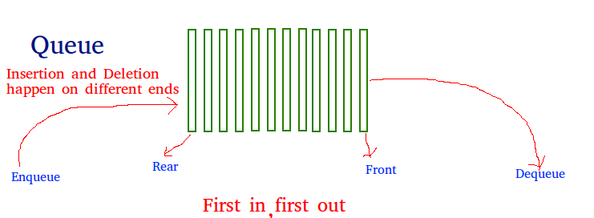
Fig :Linear queue

Slide 8
Algorithm for Insertion Operation
Step 1: IF REAR=MAX-1, then;
Write OVERFLOW
Goto Step 4
[END OF IF]
Step 2: IF FRONT == -1 and REAR = -1, then
SET FRONT = REAR = 0
ELSESET REAR = REAR + 1
Step 3: SET QUEUE[REAR] = VAL
Step 4: Exit

Slide 9
Algorithm for Deletion Operation
Step 1: IF FRONT = -1 OR FRONT > REAR,
then Write UNDERFLOW
Goto Step 3
[END OF IF]
Step 2:SET VAL = QUEUE[FRONT]
SET FRONT = FRONT + 1
Step 3: Exit

Slide 10
Circular queue
In a linear queue, the traversal through the queue is possible only once,once an element is deleted, we cannot insert another element in its position.
This disadvantage of a linear queue is overcome by a circular queue, thus saving memory.
Circular Queue is just a variation of the linear queue in which front and rear-end are connected to each other to optimize the space wastage of the Linear queue and make it efficient.

Slide 11
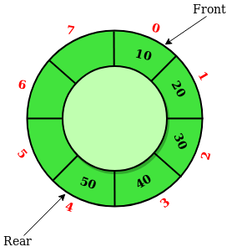
Fig:circular queue

Slide 12
Algorithm to Insert an Element in a Circular Queue
Step 1: IF (FRONT=0 && REAR=MAX–1) || (REAR=FRONT-1),
then Write “OVERFLOW”
Goto Step 4
[END OF IF]
Step 2: IF FRONT = -1 and REAR = -1, then;
SET FRONT = REAR = 0
ELSE IF REAR = MAX – 1 and FRONT != 0
SET REAR = 0
ELSE
SET REAR = REAR + 1
Step 3: SET QUEUE[REAR] = VAL
Step 4: Exit

Slide 13
Algorithm to Delete an Element from a Circular Queue
Step 1: IF FRONT = -1, then
Write “Underflow”
Goto Step 4
[END OF IF]
Step 2: SET VAL = QUEUE[FRONT]
Step 3: IF FRONT = REARSET FRONT = REAR = -1
ELSEIF FRONT = MAX -1
SET FRONT = 0
SET FRONT = FRONT + 1
Step 4: EXIT

Slide 14
Priority Queue
A priority queue is a queue in which each element is assigned a priority.
The priority of elements is used to determine the order in which these elements will be processed.
An element with higher priority is processed before an element with lower priority .
Two elements with same priority are processed on a first come first served (FCFS) basis.
Priority queues are widely used in operating systems to execute the highest priority process first.
In computer’s memory priority queues can be represented using arrays or linked lists.

Slide 15
THANK YOU!!!

